Slide 1
Subversion Basics Guide
PONGTIP AROONVATANAPORN
January 26, 2009

Slide 2
Outline
Motivation
What It’s For
URL
Features
  Tortoise
  Eclipse

Slide 3
Motivations
Use of good configuration management practice
Used by most organizations in the industry
Avoid rework
  Version tracking
  Logs
  Revert
  Conflicts and merge
Maintainability
Transition

Slide 4
Why Subversion?
CVS with added features
  Uses relational DB
  Faster performance
  Supports all file types
Available for many platforms
Easy to set up
Tools with UI support
Good internal structure
  Opportunities for future improvements

Slide 5
What it’s for
CM Tool
Version control
Check in/Check out
Synchronize updates
Detect conflicts

Slide 6
URL
Access
  svn://brown.usc.edu:3690/cs577b09/Team##
    Example: svn://brown.usc.edu:3690/cs577b09/Team01
  Username: USC email ID
  Password: <email ID>Team<##>!
    Example: John Doe of Team 1 = jdoeTeam01!

Slide 7
Tools
Tortoise SVN
  http://tortoisesvn.net/downloads
Eclipse Plug-in
  Subclipse (recommended)
    Eclipse Update Site: http://subclipse.tigris.org/update_1.4.x
  Subversive
    Part of Eclipse Update Site -> Collaboration Tools
    Need SVN Connector
      http://www.polarion.org/projects/subversive/download/eclipse/2.0/ganymede-site/

Slide 8
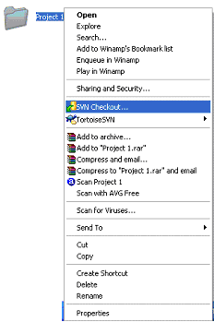
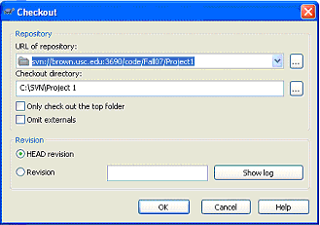
Initial Check Out (Tortoise)
Create directory on computer to download to
SVN Checkout…

Slide 9
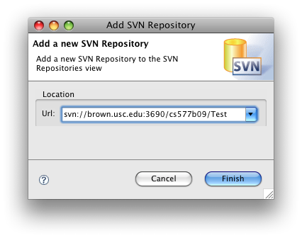
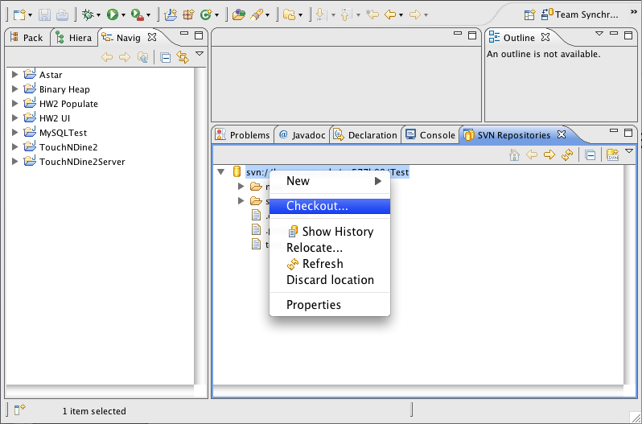
Initial Check Out (Eclipse)
Open SVN Repository perspective
Add SVN Repository URL
Right click the repository and select “Check Out”

Slide 10
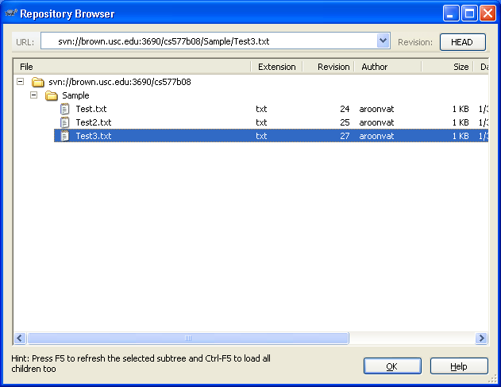
Repo-Browser
Repository browser

Slide 11
Update vs. Commit
SVN Update
  Updates the working copy with the latest version in repository
  Merges the version in repository with working copy
SVN Commit
  Modifies the version in the repository
  Merges the working copy with the repository

Slide 12
Adding/Deleting File
SVN Add
  Create file in the working directory
  Right click on file and choose “Add…”
    Add single files to the repository
  OR
  Right click on the working directory and choose “SVN Commit”
    Add all files/Changes to the repository
SVN Delete
  Deletes locally until committed

Slide 13
Other Basic Features
Revert
  Reverts all changes of the working copy to the version since last commit
Get Lock
  Locks the file so that it is only accessible by you
Release Lock
  Releases the file to make it accessible to others again
View Difference (Diff)
  View differences between working copy and the repository

Slide 14
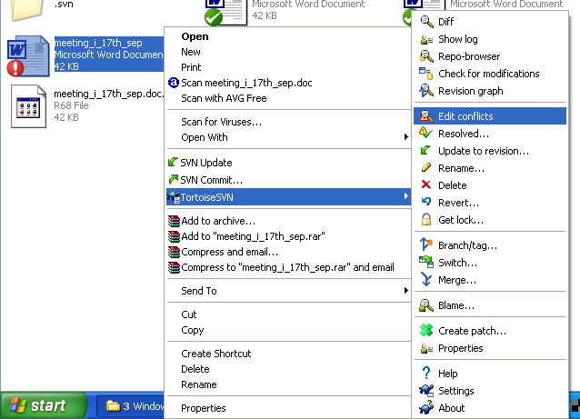
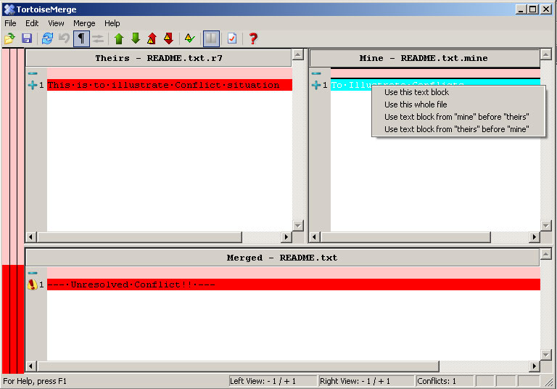
Conflict Resolution
File is simultaneously modified by multiple users
3 Files created
  Mine, OLDREV, NEWREV
The “TortoiseMerge” window
SVN Resolved

Slide 15
Advanced Features
Refer to the user manual for more advanced features
  Branch/tag
  Revision graph
  Relocate
  Export

